Slide 1
Parallel and Distributed Computing
Dr. Hammad Afzal
Military College of Signals
National University of Sciences and Technology, Pakistan
Spring, 2011
hammad.afzal@mcs.edu.pk

Slide 2
Challenges in Distributed System
The development of distributed systems is a challenging task.
Number of issues or challenges
Heterogeneity
Openness
Security
Scalability
Failure Handling
Concurrency
Transparency
Most of the challenges have already been met however we must know about them.
Notes:
DS provide us the sharing of resources. The development of distributed systems is a challenging task. There are number of issues or challenges which arise during the development of a distributed system. Most of the challenges have already been met however we must know about them.
Heterogeneity
Openness
Security
Scalability
Failure Handling
Concurrency
Transparency

Slide 3
Heterogeneity
World Wide Web is a distributed system which allows the users to share different resources.
The WWW users may access services over heterogeneous collection of computers and networks.
The term heterogeneity applies to the following
Computers
Network
Operating Systems …..
Programming Languages

Slide 4
Heterogeneity
Mask the heterogeneity due to different networks.
Network protocols (TCP/IP) used for the communication.
Problem still exists
Difference in the representation of Programming Languages
Difference in Data types representation/ byte order.
E.g. Big Endian/Little Endian: integers may be represented differently on different computers.
Solution
Middleware: A software layer that provides the abstraction thus masking the heterogeneity.
E.g. Java RMI, CORBA
Notes:
But problem may arise between the programs running on two different machines when messages are exchanged between them. e.g. integers may be represented differently on different computers.

Slide 5
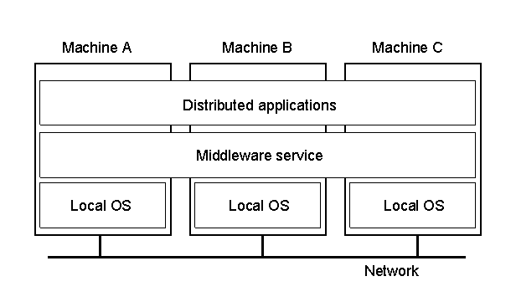
Distributed System
A distributed system organized as middleware. Note that the middleware layer extends over multiple machines.

Slide 6
Heterogeneity
Mobile Code and Heterogeneity
Mobile code is the one that can be sent from one computer to the other.
Machines may be different, and code for one application might not run on other.
Example: Java Applets.
Virtual Machine: Solution for Mobile Code
Its allows the code to be executed on any particular machine.
The compiler generates code for the virtual machine which in turn generates the code for the underlying hardware.
Notes:
Internet protocols are responsible for the transmission of data between the two computers. But what when the data reaches within the computer. E.g. I had made a program in java on 1 PC. Now when program starts then it sends the request to other program made in C++ on PC 2. The problem will arise as Java uses different style for storing the integers.
Middleware: The term refers to a software layer that provides the abstraction thus masking the heterogeneity. CORBA is an example which will be discussed in the later chapters.
Mobile Code: Mobile code is the one that can be sent from one computer to the other. E.g. Java Applets.
Virtual Machine: Its allows the code to be executed on any particular machine. The compiler generates code for the virtual machine which in turn generates the code for the underlying hardware.

Slide 7
Openness
Openness:
Computer system can be extended or not ?
The degree to which the new resource and services can be added and made available for use by a variety of client programs.
Can be achieved with published Interfaces
On every system in DS, there are different programs or components which are running.
In order to use these components we should be able to utilize their functionality.
Every component has key interfaces via which we can use its functions and hence the functionality.
So these interfaces must be published i.e. developers can use them.
Notes:
Openness:
Computer system can be extended or not ?
E.g. I have 1 GB ram in the computer. Can I extend it ? and so on.
While openness of a distributed system mean the degree to which the new resource and services can be added and made available for use by a variety of client programs.
In distributed system on every system there are different programs or components which are running. In order to use these components we should be able to utilize their functionality. Every component has key interfaces via which we can use its functions and hence the functionality. So these interfaces must be published i.e. developers can use them.
Publishing is the only starting point. So that component or program can be updated but it will be difficult to update if different developers are working on the came component.

Slide 8
Openness
Open systems
Offer services according to standard rules that describe these services.
The documentation and specifications are made available to the developers
Neutral and complete specifications
RFCs for Network protocols
Self Study: Read RFC-791 for IPv4

Slide 9
Openness
Advantages of being open:
Interoperability
Extent by which two implementations of systems or components from different manufacturers can co-exist and work together.
Portability
An application developed for DS-A can be executed without modification on DS-B.
Open systems can work together;
Ability to transfer an application from one software
or hardware platform to another

Slide 10
Security
DS maintain the information resources for the users.
The security of such resources is important.
Confidentiality:
Protection against disclosure to the unauthorized individuals.
Integrity:
Protection against the alteration or corruption.
Examples
A doctor might request access to hospital patient data
In electronic commerce and banking, users send their credit card numbers across the internet

Slide 11
Security
Availability:
Genuine users should be given immediate access to the resource.
Solutions
Firewall
Encryption (more comprehensive security approach than firewall)
Current security challenges
Denial of service attack
Notes:
Firewalls
In a DS client may send request to server to perform a specific operation.
Now server must check the identity of the individual. Then it must make sure that request had been made by the authentic individual.
How we can solve this thing ?
Encryption

Slide 12
Scalability
DS is said to be scalable if it remains effective when there is a significant increase in the number of resources and number of users.
Internet provides an illustration of the DS in which number of computers and services have increased dramatically
Computers in the Internet
Date
Computers
Web servers
1979, Dec.
188
0
1989, July
130,000
0
1999, July
56,218,000
5,560,866
2003, Jan.
171,638,297
35,424,956

Slide 13
Scalability (contd.)
Following Issues should be Focused
1. Controlling the cost of physical resources
As demand for resource grows we can extend the system via adding more resources at a reasonable cost.
E.g. the frequency with which the files are accessed may increase with the increase in no of users. So we can purchase another file server to avoid the bottleneck and improve the performance.

Slide 14
Scalability (contd.)
2. Controlling the performance loss
Consider set of data, whose size is proportional to number of users or resources. E.g. DNS (a distributed Database)
When we make a query then specific algorithm runs on the back end to find the data.
Instead of linear we should use appropriate (hierarchically) algorithms which work better in case of scalability.

Slide 15
Scalability (contd.)
Preventing software's resources running out
An example of lack of scalability
An example is IP addresses.
First 32 bits were used and now 128 bit has been provided.
So in the future if this issue raised then other problem will arise and components will be required to be updated.

Slide 16
Scaling Techniques
Three techniques:
Hiding communication latencies
Try to avoid waiting for responses to remote service requests as much as possible
Distribution
Replication

Slide 17
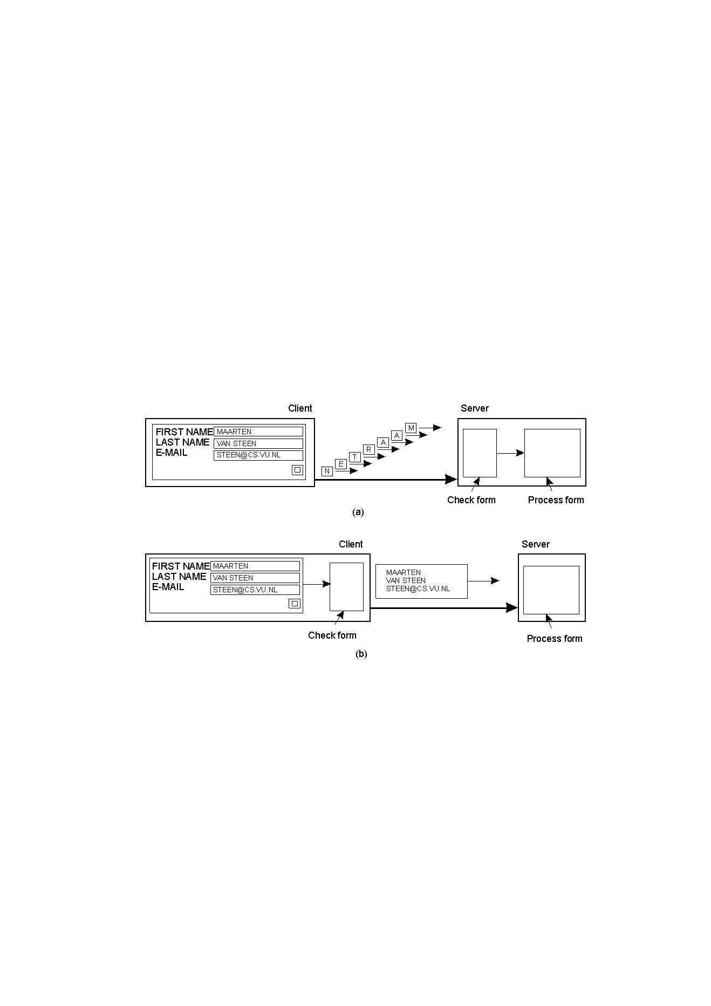
Scaling Techniques (1)
1.4
The difference between letting:
a server or
a client check forms as they are being filled

Slide 18
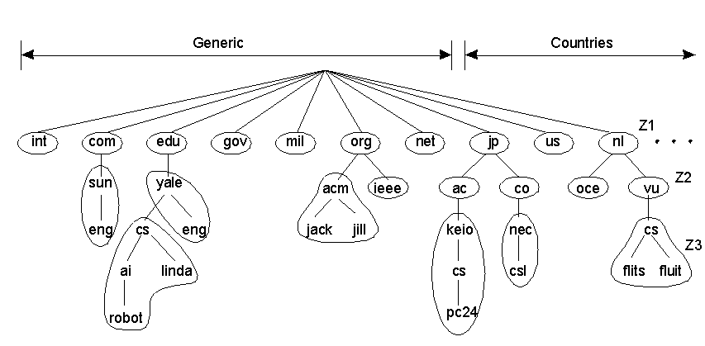
Scaling Techniques (2)
1.5
An example of dividing the DNS name space into zones.

Slide 19
Scaling Techniques (3)
Replication
Increases availability
Reduces communication latency
But causes consistency problems
Caching (client-driven)

Slide 20
Failure Handling
Independent Failures
Failures may occur in different ways. Failures in a DS are partial i.e. some components may fail while others will keep on working.

Slide 21
Failure Handling
Detecting failure
Checksum can be used to detect corrupted data
System crash
Masking/Hiding
Retransmission
Redundant storage
Tolerating failure
Timeout when waiting for web sources

Slide 22
Failure Handling
Recovery from failure
Roll back
Redundancy (services can be made tolerate failures)
Redundant routes in network
Replication of DNS tables in multiple domain name servers
Availability
Measure of the proportion of the time a server is available
User may move to another computer if the one they were using fails

Slide 23
Concurrency
Multiple clients may use the same resource at the same time
E.g. a data structure that records online bids may be accessed frequently when the deadline is near to end.
Process manages resource and it should allow multiple users to access it.
E.g. resource is encapsulated as an object and that invocations are executed in concurrent threads.
In this case several threads are executing concurrently with in an object and the operations should not conflict with each other and should provide the consistent results.
For an object to be safe in a concurrent environment its operations must be synchronized in such a way that its data remains consistent.

Slide 24
Transparency
Concealment of different and separation of components from the users and application programmers.
They will always perceive that there is a single system who is performing their requests.
Access Transparency: Enables local and remote resources to be accessed using identical operations
E.g. streams read write in same way.
Location Transparency: Enable resources to be accessed without knowledge of their physical or network location.
E.g. URL’S is location transparent.

Slide 25
Transparency
Failure Transparency:
Enables the concealment of faults, allowing users and application programs to complete their tasks despite the failure of hardware or software components. e.g. retransmission etc.
Mobility transparency
Allows the movement of resources and clients with in a system without affecting the operation of users. E.g. mobile phone.
Both caller (client) and callee (resource) are traveling to different places.
Two Most Important : Access and Location Transparency
Network Transparency

Slide 26
Challenges :Transparency
Concurrency transparency: enables several processes to operate concurrently using shared resources without interference between them.
Scaling transparency: allows the system and applications to expand in scale without change to the system structure or the application algorithms.

Slide 27
Degree of transparency
Transparency is
Not always desirable
Users located in different continents (restricted websites/contents)
Users trying to access local resources (Printers etc)
Not always possible
Hiding failures
(you can’t distinguish a slow computer from a failing one)

Slide 28
End of Chapter 1

Slide 29
Courtesy
Following people’s lecture slides have also been consulted during the preparation of this lecture.
Dr. Rehan Rasool (SEECS)
Umar Kalim (Ex-SEECS)
Dr. Faisal Bashir (MCS)
Dr. Hammad Afzal

